Slide 1
NUTRITIONAL AND FOOD RELATED HEALTH CONDITIONS Grade 12 Term 2 Week 2 Lesson 1

Slide 2
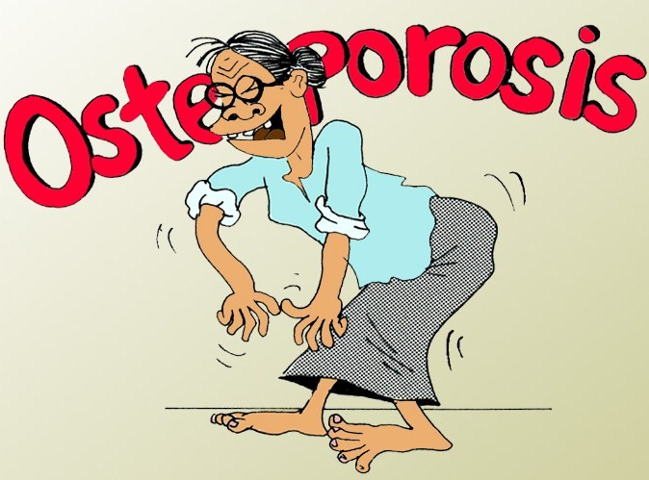

Slide 3
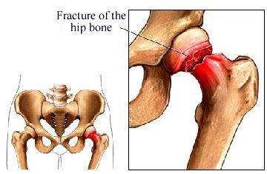
What is osteoporosis
The disease where bone density is reduced due to loss of calcium and other important minerals.
The bones become
increasingly porous
and fracture easily.

Slide 4
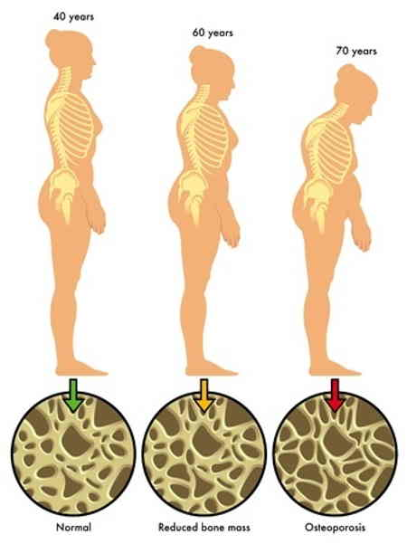
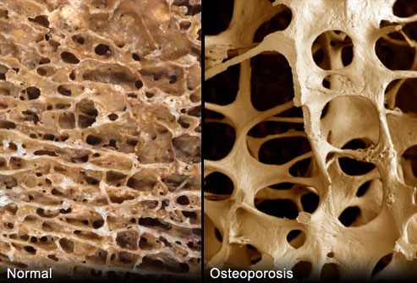

Slide 5
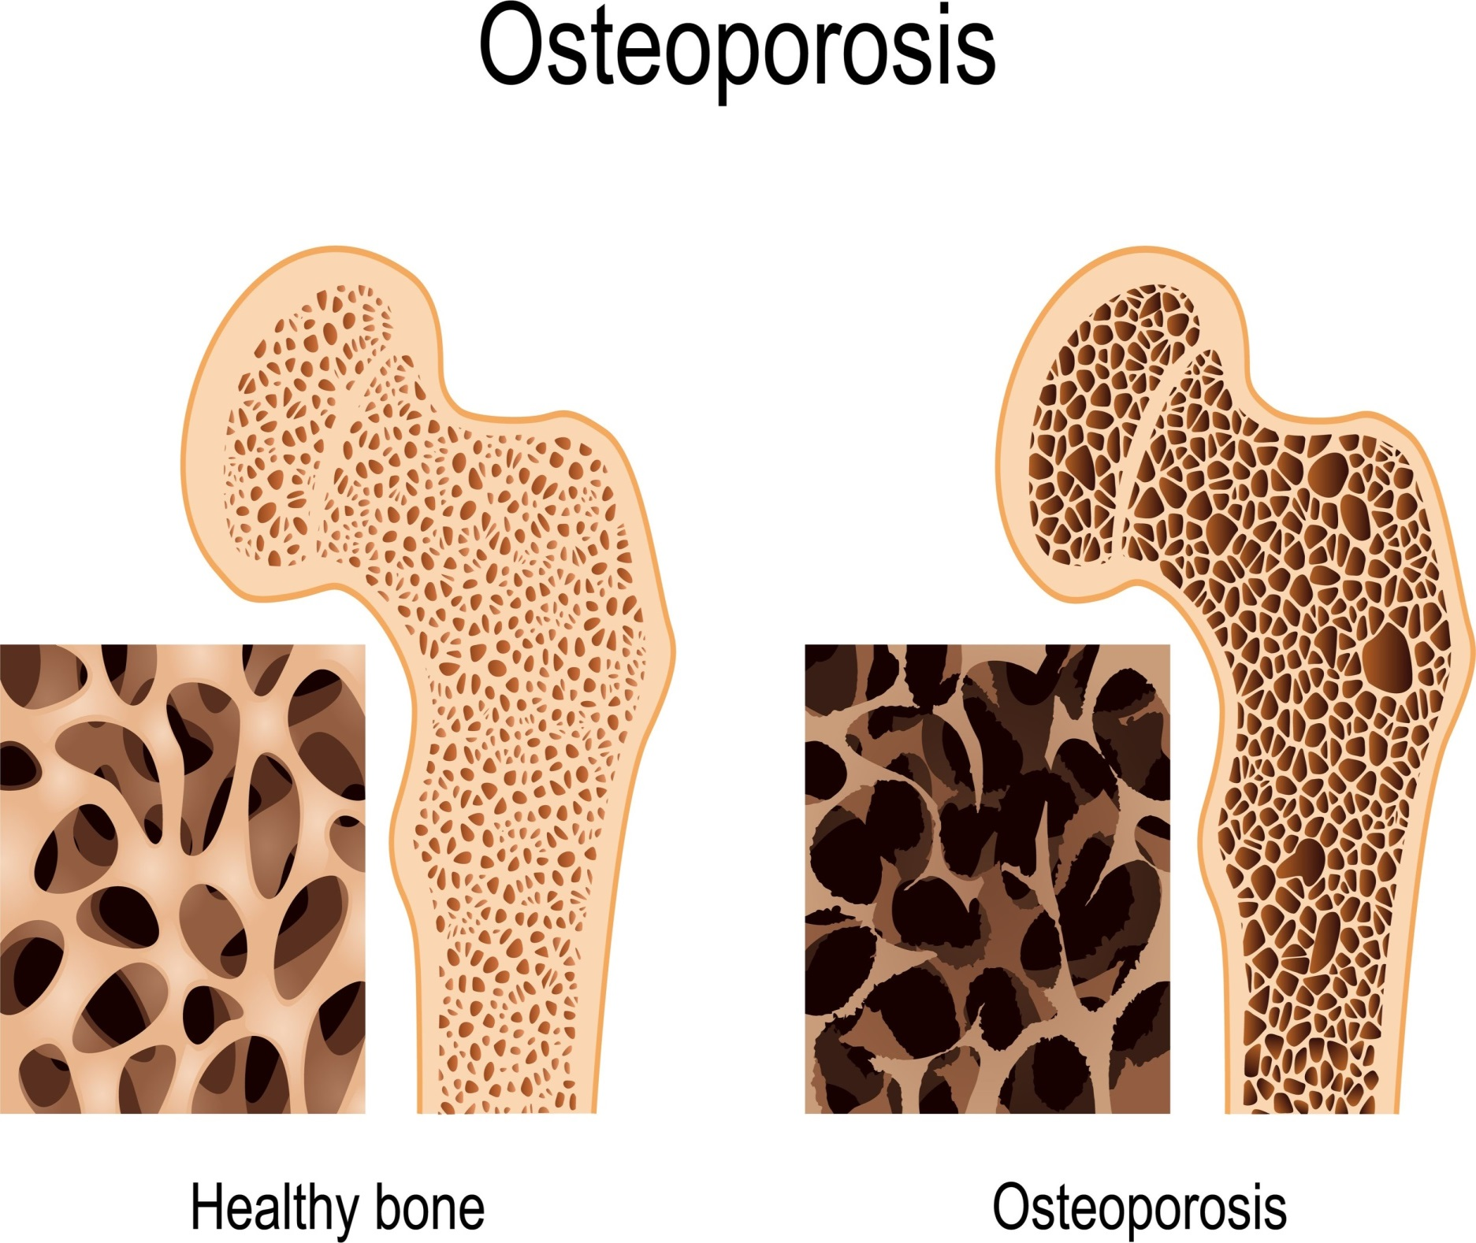

Slide 6
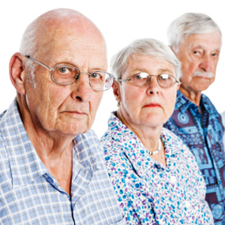
Causes and risk factors of developing osteoporosis
Poor diet: low in calcium, phosphorus
and vitamin D.
Genetic factor/family
history of osteoporosis.
Body shape: short, small
framed people
Gender: low oestrogen
levels in women
Age: menopausal women
lose calcium quickly
Disease of hormone replacing glands
Weight loss due to anorexia and
excessive exercise
Alcohol and smoking

Slide 7
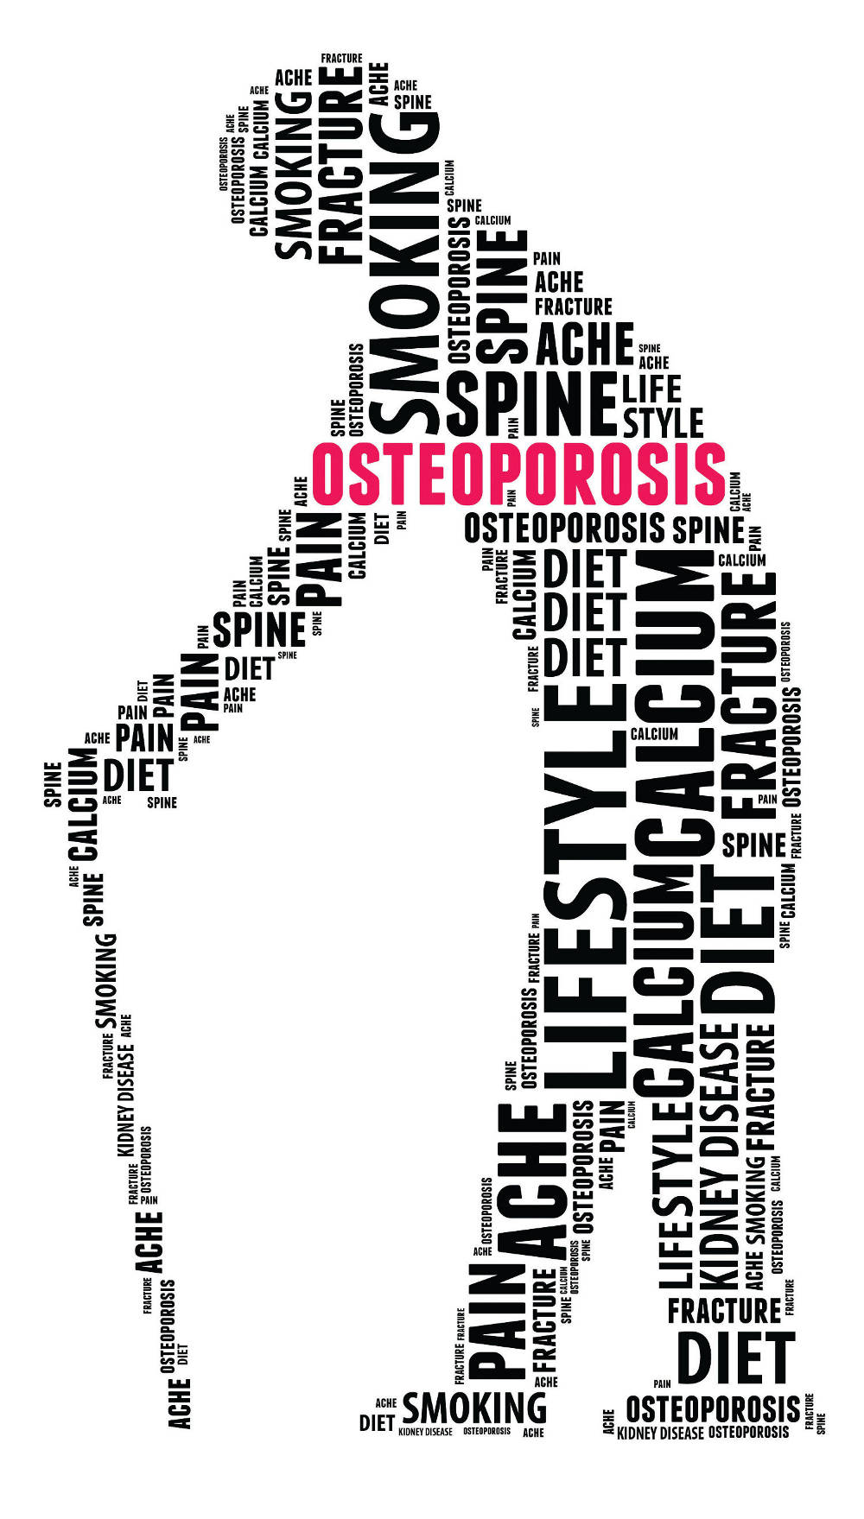
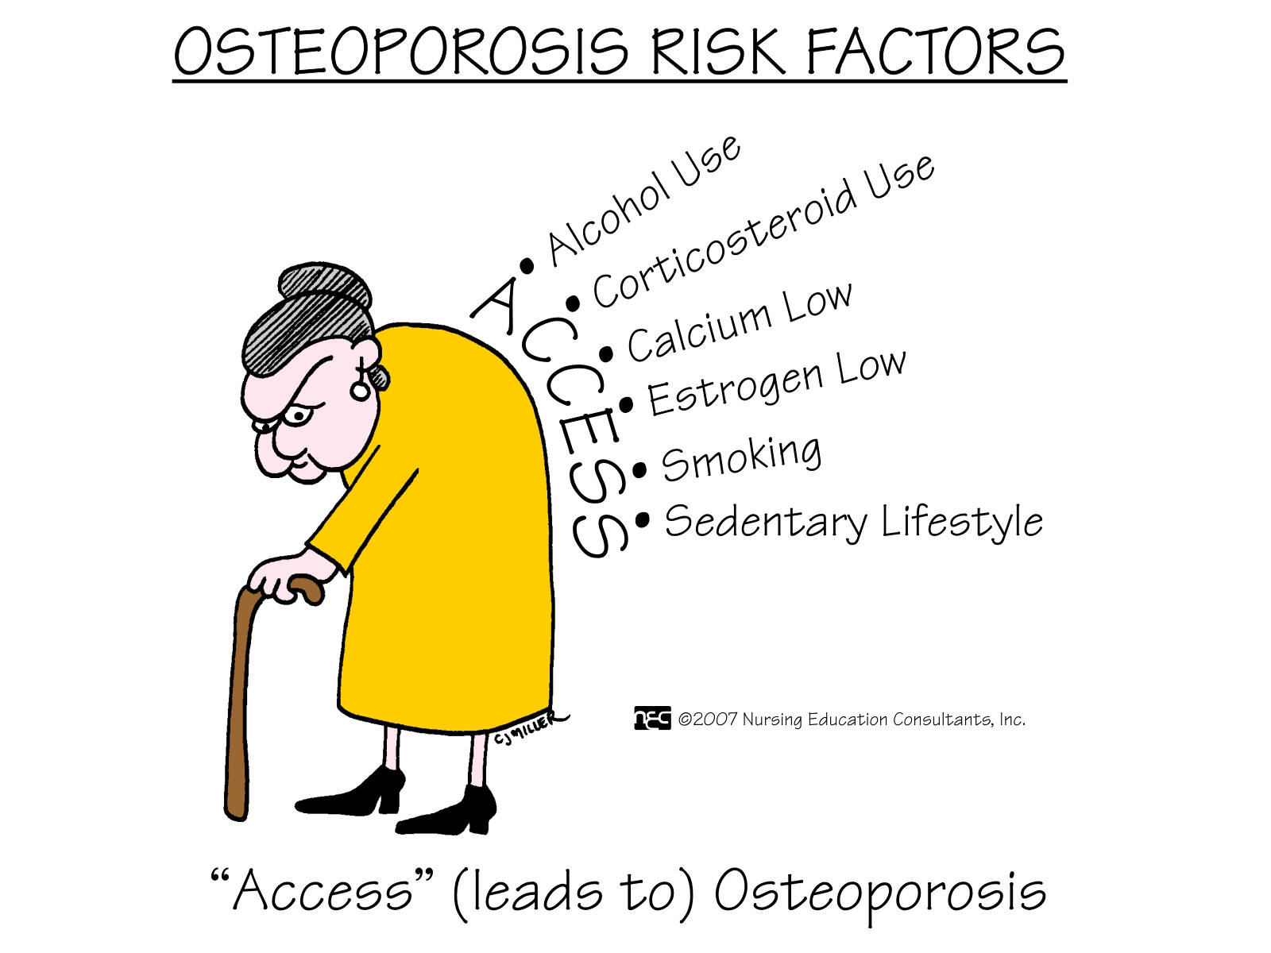
Are you at risk?

Slide 8
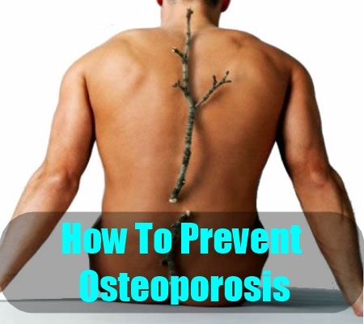
Notes:
Show pupils all the information needed on a food label

Slide 9

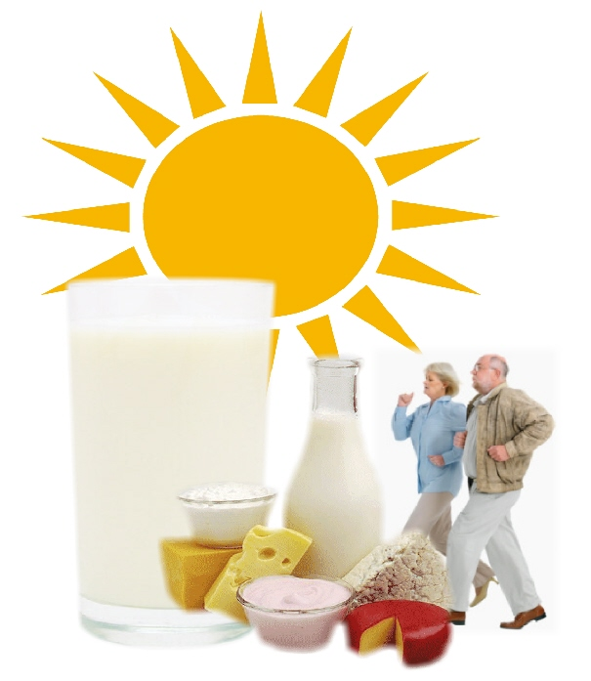
Regular exercise
Calcium rich food

Slide 10
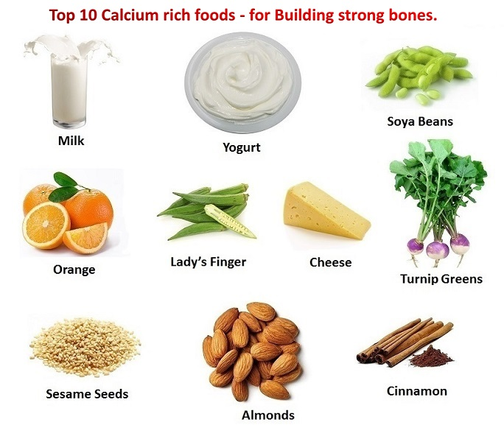

Slide 11
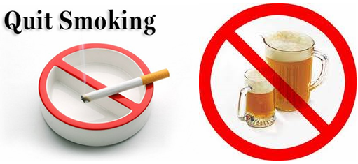
You need strong bones today
Eat a balanced diet rich in calcium
Ensure an adequate intake
of vitamin D
Include sufficient amount
of phosphorus
Ensure sufficient intake
of kilojoules
Do regular weight-bearing exercise
Do not smoke or drink excessive amount of alcohol
Limit tea or coffee
An adequate fluoride intake is recommended

